Slide 1





CNET 101
Computer Networks
Tutorial 5

Slide 2



1. HTTP
Outline
2. DNS

Slide 3


1. HTTP
Cookies
Caches

Slide 4

Cookies
Also called web cookie, Internet cookie, browser cookie, or simply cookie.
It is a small piece of data sent from a website and stored on the user's computer by the user's web browser while the user is browsing, and another copy is sent to the backend database of the browser.
Cookies were designed to be a reliable mechanism for websites to remember stateful information.
Such as:
Items added in the shopping cart in an online store (as in Jumia, Noon, eBay, Amazon, … etc).
Record the user's browsing activity including clicking buttons. Logging in sessions, preference language.

Slide 5


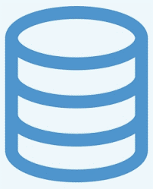


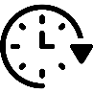
Cookies
When you send a request to the server, the server sends a reply in which it embeds the cookie which serves as an identifier to identify the user. So, next time when you visit the same website, the cookie lets the server know that you are visiting the website again.
Computer
FB Server
FB Backend Database
Four components:
Cookies File
FB = 1234
TCP Request
Cookie file kept on user’s host, managed by user’s browser.
TCP Response
HTTP Request
Create Entry
With ID = 1234
HTTP Response
Set-Cookie = 1234
New User
Create ID
Cookie header line in HTTP response message.
Back-end database at Web site.
HTTP Request
Cookie = 1234
Cookie header line in HTTP request message.
Access
ID = 1234
HTTP Response
Cookie
Specification

Slide 6
Caches
Web caching is the activity of storing data for reuse, such as a copy of a web page served by a web server.
It is cached or stored the first time a user visits the page and the next time a user requests the same page, a cache will serve the copy, which helps keep the origin server from getting overloaded and saves time.
Also known as Proxy Server.
Efficient Web Caching process is to store the frequently requested resources using Popularity Count.
Cache content expires after a certain period, if no one requested.

Slide 7
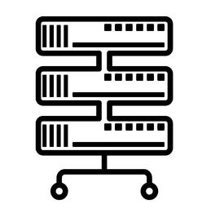



Caches
If object isn’t in cache, then cache will request object from origin server.
Computer
Proxy Server
FB Server
TCP Request
TCP Response
Browser sends all HTTP requests
to cache (Proxy Server).
HTTP Request
TCP Request
TCP Response
HTTP Request
HTTP Response
HTTP Response
Saves a copy and return object to client.

Slide 8
Caches
While if object is in cache, cache will return object directly.
Satisfy client request without involving origin server.
Computer
Proxy Server
FB Server
TCP Request
TCP Response
HTTP Request
HTTP Response
RTT between Computer and Proxy Server is much less than RTT between Computer and Origin Server.

Slide 9
Caches
Cache acts as both client and server (because it sends HTTP request and HTTP response messages).
Typically, cache is installed by ISP (university, company, residential areas).
Why Web caching?
Reduce response time for client request.
Reduce traffic on the access link to avoid congestion bottlenecks.

Slide 10
Caches – Conditional GET
That’s why Cache must specify date of cached copy in HTTP request.
If-modified-since: <date>
Server HTTP response:
contains no object if cached copy is up-to-date: HTTP/1.0 304 Not Modified.
contains object if cached copy modified: HTTP/1.0 200 ok <data>.
HTTP Request
If-modified-since: <date>
No
Yes
HTTP Response
HTTP/1.0 304 Not Modified
HTTP Response
HTTP/1.0 200 ok
<data>

Slide 11
Caches
Computer
Proxy Server
FB Server
TCP Request
TCP Response
HTTP Request
TCP Request
TCP Response
HTTP Request
If-modified-since: <date>
HTTP Response
HTTP Response
HTTP/1.0 304 Not Modified
HTTP Request
HTTP Request
If-modified-since: <date>
HTTP Response
HTTP Response
HTTP/1.0 200 ok
<data>

Slide 12
Cookies Vs. Caches
Cookies | Caches
Cookie is used to store information to track different characteristics related to user. | Cache is used to make the loading of web pages faster.
Cookies stores information such as user preferences. | Cache will keep resource files such as audio, video or any type of files.
Cookies expire after some time. | Cache is kept in the client’s machine until they are removed manually by the user or expires after a certain period, if no one requested.

Slide 13

2. DNS
Iterative Query
Recursive Query

Slide 14

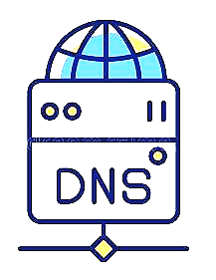
DNS
The Domain Name System (DNS) is the phonebook of the Internet.
Humans access information online through domain names, like facebook.com or instagram.com. Web browsers interact through Internet Protocol (IP) addresses.
DNS translates domain names to IP addresses so browsers can load Internet resources.
Computer
DNS Server
Data
Application Layer
Encapsulate
Segment
Port #
80
Transport Layer
DNS Query
What is the IP address
of www.facebook.com
Packet
IP
SRC DST
Port #
80
Internet Layer
DNS Response
157.240.22.35
IP SRC already known (DHCP)
IP DST unknown ??
Network Interface
DNS Query needed.

Slide 15
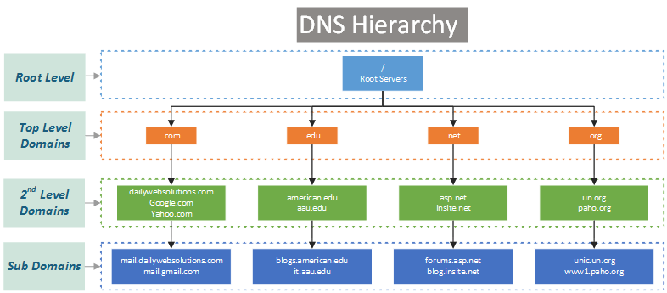
DNS
DNS is an application-layer protocol.
Distributed database implemented in hierarchy of many name servers.
Why distributed not centralized?
Single point of failure.
Traffic Volume. (avoid congestions)
Distant centralized database. (less delay)
Maintenance: update huge data base.
Hierarchy Levels
Root DSN Server.
Top Level Domain (TLS) Servers.
Authoritative Servers.
Root Server
Authoritative Servers

Slide 16
DNS Services
Hostname-to-IP-address translation.
Host Aliasing
Alias names “Familiar” www.facebook.com
Canonical Real Names www.east-coast.facebook.com
Load Distribution
Replicated Web servers: set of IP addresses for one canonical name.
Once local DNS server learns mapping, it caches mapping.
Cache entries expire after some time (timeout often 48 hours).
TLD servers typically cached in local name servers, thus root name servers not often visited.
URL | IP
www.facebook.com | 157.240.22.35

Slide 17
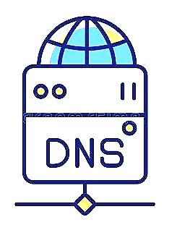

DNS Iterative Query
Root DNS Server
Acts as proxy,
forwards query into hierarchy.
Computer
Local Name Server
TLD DNS Server
DNS Query
DNS Response
Authoritative DNS Server
TCP Request
TCP Response
HTTP Request
FB Server
HTTP Response
Notes:
DNS Protocol doesn’t receive or send HTTP requests, they only understand DNS Queries & responses.

Slide 18
DNS Recursive Query
Root DNS Server
Not so common.
Acts as proxy,
forwards query into hierarchy.
Computer
Local Name Server
TLD DNS Server
DNS Query
DNS Response
Authoritative DNS Server
TCP Request
TCP Response
HTTP Request
FB Server
HTTP Response
Notes:
DNS Protocol doesn’t receive or send HTTP requests, they only understand DNS Queries & responses.

Slide 19


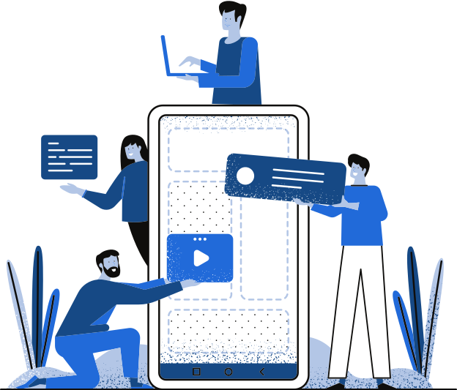
THANK YOU!
THANK YOU!
Any Questions?

